Slide 1


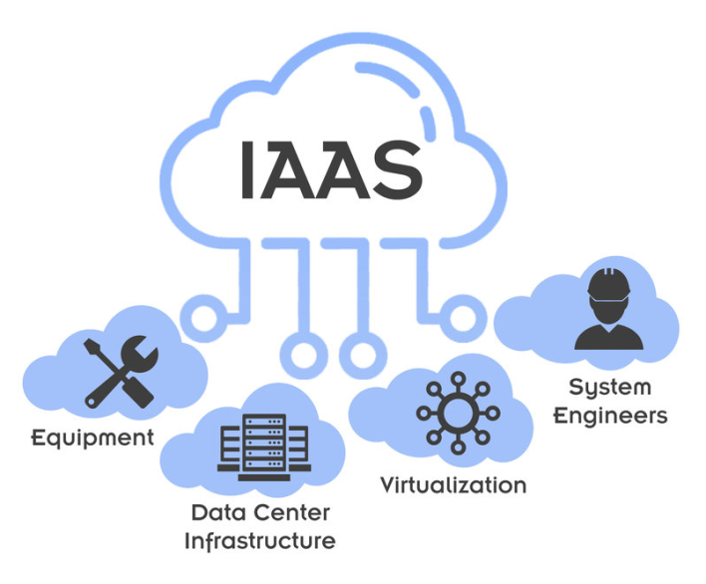
Amazon Web Services
https://bit.ly/3vdPLxh

